Slide 1
Advanced CSS

Slide 2
CSS Selectors

Slide 3
CSS Selectors
Selector | Example | Example description
.class | .intro | Selects all elements with class="intro"
#id | #firstname | Selects the element with id="firstname"
* | * | Selects all elements
element | p | Selects all <p> elements
element,element | div, p | Selects all <div> elements and all <p> elements
element element | div p | Selects all <p> elements inside <div> elements
element > element | div > p | Selects all <p> elements where the parent is a <div> element
element + element | div + p | Selects all <p> elements that are placed immediately after <div> elements
element1 ~ element2 | p ~ ul | Selects every <ul> element that are preceded by a <p> element

Slide 4
CSS Selectors
Selectors https://www.w3schools.com/cssref/css_selectors.asp
Selector Tester https://www.w3schools.com/cssref/trysel.asp

Slide 5
CSS Units

Slide 6
CSS Units
Absolute lengths
Unit Description cm centimeters mm millimeters px pixels (1px = 1px is one device pixel (dot)) pt points (1pt = 1/72 of 1in)

Slide 7
CSS Units
Relative lengths
Unit Description % Relative to the parent element em Relative to the font-size of the element (2em means 2 times the size of the current font) rem Relative to font-size of the root element

Slide 8
CSS Units
Units https://www.w3schools.com/cssref/css_units.asp

Slide 9
CSS Colors

Slide 10
CSS Colors
Color methods
Hexadecimal colors
RGB colors
RGBA colors

Slide 11
CSS Hexadecimal Colors
#RRGGBB where the RR (red), GG (green) and BB (blue) hexadecimal integers specify the components of the color. All values must be between 00 and FF.
#p1 {background-color: #ff0000;} /* red */
#p2 {background-color: #00ff00;} /* green */
#p3 {background-color: #0000ff;} /* blue */

Slide 12
CSS RGB Colors
rgb(red, green, blue) Each parameter (red, green, and blue) defines the intensity of the color and can be an integer between 0 and 255 or a percentage value (from 0% to 100%).
#p1 {background-color: rgb(255, 0, 0);} /* red */
#p2 {background-color: rgb(0, 255, 0);} /* green */
#p3 {background-color: rgb(0, 0, 255);} /* blue */

Slide 13
CSS Colors
Colors https://www.w3schools.com/cssref/css_colors_legal.asp
https://www.w3schools.com/css/css_colors.asp

Slide 14
CSS Box Model

Slide 15
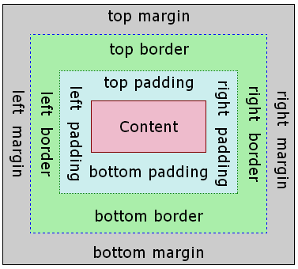
CSS Box Model
Content - The content of the box, where text and images appear
Padding - Clears an area around the content. The padding is transparent
Border - A border that goes around the padding and content
Margin - Clears an area outside the border. The margin is transparent

Slide 16
CSS Box Model
Assume we want to style a <div> element to have a total width of 350px: div {
width: 320px;
padding: 10px;
border: 5px solid gray;
margin: 0;
}
320px (width) + 20px (left + right padding) + 10px (left + right border) + 0px (left + right margin) = 350px

Slide 17
CSS Box Model
Box Model https://www.w3schools.com/css/css_boxmodel.asp

Slide 18
CSS display property

Slide 19
CSS display property
The display property is the most important CSS property for controlling layout.
The display property specifies if/how an element is displayed.
The default display value for most elements is block or inline.

Slide 20
CSS display property: Block-level Elements
Block-level Elements
A block-level element always starts on a new line and takes up the full width available (stretches out to the left and right as far as it can).
Examples of block-level elements:
<div>
<h1> - <h6>
<p>
<form>
<header>
<footer>
<section>

Slide 21
CSS display property: Inline Elements
Inline Elements
An inline element does not start on a new line and only takes up as much width as necessary.
Examples of inline elements:
<span>
<a>
<img>

Slide 22
CSS display property
display property https://www.w3schools.com/css/css_display_visibility.asp
https://www.w3schools.com/cssref/pr_class_display.asp

Slide 23
CSS float property

Slide 24
CSS float property
The CSS float property specifies how an element should float.

Slide 25
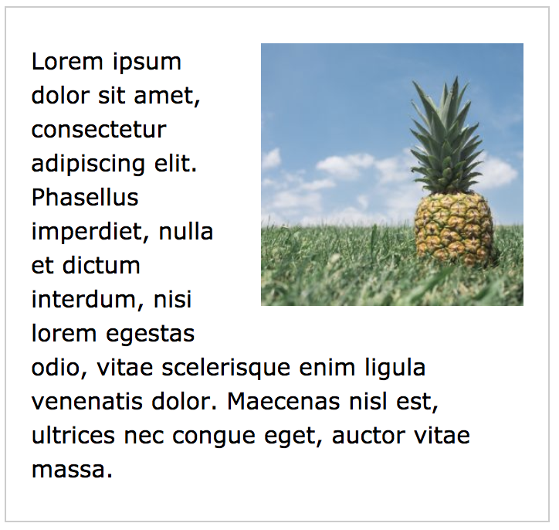
CSS float property
Example - float: right;
img {
float: right;
}

Slide 26
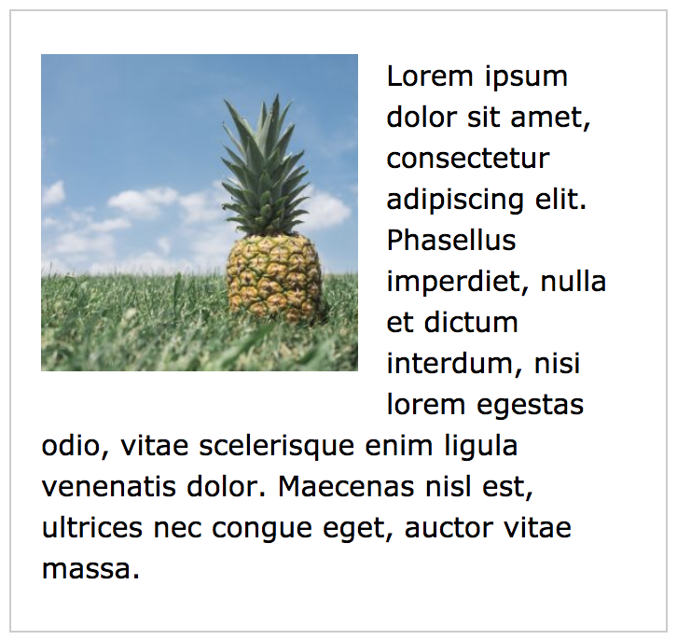
CSS float property
Example - float: left;
img {
float: left;
}

Slide 27
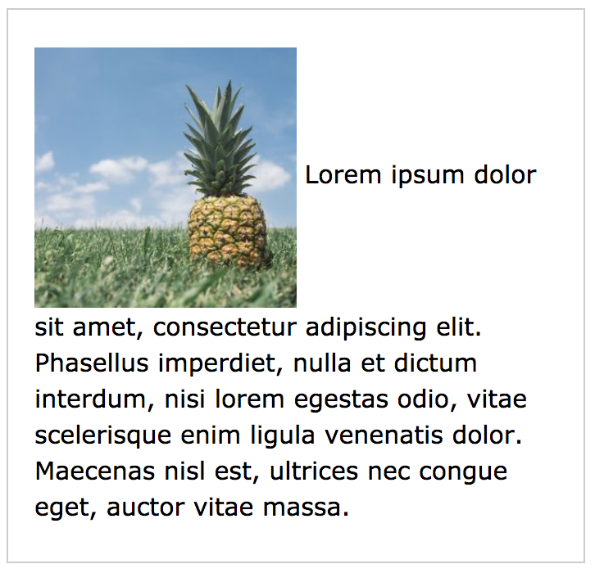
CSS float property
Example - no float
img {
float: none;
}

Slide 28
CSS float property
float property https://www.w3schools.com/css/css_float.asp

Slide 29
CSS position property

Slide 30
CSS position property
The position property specifies the type of positioning method used for an element (static, relative, absolute, fixed).

Slide 31
CSS position property
Value | Description
static | Default value. Elements render in order, as they appear in the document flow
absolute | The element is positioned relative to its first positioned (not static) ancestor element
fixed | The element is positioned relative to the browser window
relative | The element is positioned relative to its normal position, so "left:20px" adds 20 pixels to the element's LEFT position

Slide 32
CSS position property
position property https://www.w3schools.com/cssref/pr_class_position.asp

Slide 33
Specificity
Most important thing

Slide 34
CSS Specificity
Every selector has its place in the specificity hierarchy. There are four categories which define the specificity level of a selector:
Inline styles - An inline style is attached directly to the element to be styled. Example: <h1 style="color: #ffffff;">.
IDs - An ID is a unique identifier for the page elements, such as #navbar.
Classes, attributes and pseudo-classes - This category includes .classes, [attributes] and pseudo-classes such as :hover, :focus etc.
Elements and pseudo-elements - This category includes element names and pseudo-elements, such as h1, div, :before and :after.

Slide 35
CSS Specificity
A selector's specificity is calculated as follows:
count 1 if the declaration is from is a 'style' attribute rather than a rule with a selector, 0 otherwise (= a)
count the number of ID attributes in the selector (= b)
count the number of classes, other attributes and pseudo-classes in the selector (= c)
count the number of element names and pseudo-elements in the selector (= d)

Slide 36
CSS Specificity
* {} /* a=0 b=0 c=0 d=0 -> specificity = 0,0,0,0 */
li {} /* a=0 b=0 c=0 d=1 -> specificity = 0,0,0,1 */
li:first-line {} /* a=0 b=0 c=0 d=2 -> specificity = 0,0,0,2 */
ul li {} /* a=0 b=0 c=0 d=2 -> specificity = 0,0,0,2 */
ul ol+li {} /* a=0 b=0 c=0 d=3 -> specificity = 0,0,0,3 */
h1 + *[rel=up]{} /* a=0 b=0 c=1 d=1 -> specificity = 0,0,1,1 */
ul ol li.red {} /* a=0 b=0 c=1 d=3 -> specificity = 0,0,1,3 */
li.red.level {} /* a=0 b=0 c=2 d=1 -> specificity = 0,0,2,1 */
#x34y {} /* a=0 b=1 c=0 d=0 -> specificity = 0,1,0,0 */
style="" /* a=1 b=0 c=0 d=0 -> specificity = 1,0,0,0 */

Slide 37
CSS specificity
https://www.w3schools.com/css/css_specificity.asp
https://css-tricks.com/specifics-on-css-specificity/
https://www.w3.org/TR/CSS21/cascade.html#specificity
https://specificity.keegan.st/

Slide 38
Sorry guys, but you need to read, read, read, read, read, read, read, read, read, read, read, read, read, read, read, read, read, read, read, read, read, read, read, read, read, read, read, read, read, read, read, read, read, read, read, read, read, read, read, read,

